Slide 1
THE LIFE OF CHRIST
PART 67

Slide 2
John 11:1 Now a certain man was sick, Lazarus of Bethany, the town of Mary and her sister Martha. ² It was that Mary who anointed the Lord with fragrant oil and wiped His feet with her hair, whose brother Lazarus was sick.

Slide 3
John 11:3 Therefore the sisters sent to Him, saying, "Lord, behold, he whom You love is sick." ⁴ When Jesus heard that, He said, "This sickness is not unto death, but for the glory of God, that the Son of God may be glorified through it."

Slide 4
John 11:5 Now Jesus loved Martha and her sister and Lazarus. ⁶ So, when He heard that he was sick, He stayed two more days in the place where He was.

Slide 5
John 11:7 Then after this He said to the disciples, "Let us go to Judea again." ⁸ The disciples said to Him, "Rabbi, lately the Jews sought to stone You, and are You going there again?"

Slide 6
John 11:9 Jesus answered, "Are there not twelve hours in the day? If anyone walks in the day, he does not stumble, because he sees the light of this world. ¹⁰ "But if one walks in the night, he stumbles, because the light is not in him."

Slide 7
John 11:11 These things He said, and after that He said to them, "Our friend Lazarus sleeps, but I go that I may wake him up." ¹² Then His disciples said, "Lord, if he sleeps he will get well." ¹³ However, Jesus spoke of his death, but they thought that He was speaking about taking rest in sleep. ¹⁴ Then Jesus said to them plainly, "Lazarus is dead.

Slide 8
There are many times in the Scriptures that death is called sleep (Dan. 12:2; Mt. 27:52; Acts 7:60; 1 Thes. 4:13).

Slide 9
Of all that Jesus ever said of death, this is the most encouraging. (1) Sleep is a temporary thing; and so by this our Lord revealed that death too is not permanent. (2) Sleep refreshes and rejuvenates; thus in the resurrection this mortal shall put on immortality and this corruptible shall put on incorruption. (3) From sleep, men awaken; and the promise is secure in the Master's words that all that are in the tombs "shall come forth" (John 5:29). (4) Sleep is a time of rest; and the dead also "shall rest from their labors" (Revelation 14:13). The respect of the human race for this word of Jesus Christ is revealed in the fact of their inscribing these words, "Asleep in Jesus," upon millions of tombs in all ages since then (John 11 Coffman Commentaries).

Slide 10
It is the body that returns back to the earth, and the spirit returns to God (Dan. 12:2; Ecc. 12:7).
This can be seen in the story of the rich man and Lazarus (Lk. 16:19-31).
Also, we can see that the wicked are said to be under punishment prior to the judgment day, which means their souls are alive as well (2 Pet. 2:9).
There are many other passages that teach that our souls do not remain in the body after death and that we are conscious after death (Lk. 23:43; 2 Cor. 5:8; Phil. 1:21-23; Rev. 6:9-11; 7:15-17; 20:4).

Slide 11
John 11:15 "And I am glad for your sakes that I was not there, that you may believe. Nevertheless let us go to him." ¹⁶ Then Thomas, who is called the Twin, said to his fellow disciples, "Let us also go, that we may die with Him."

Slide 12
John 11:17 So when Jesus came, He found that he had already been in the tomb four days.

Slide 13
According to rabbinical tradition, the soul of a deceased person hovers around the body for three days in hope of a reunion, but takes its final departure when it notices that the body has entered a state of decomposition (William Hendriksen, op. cit., II, p. 146 “Quoted from Coffman’s Commentary on John”).

Slide 14
John 11:18 Now Bethany was near Jerusalem, about two miles away. ¹⁹ And many of the Jews had joined the women around Martha and Mary, to comfort them concerning their brother.

Slide 15
... The rules laid down by rabbis, required seven days' public and thirty days' private mourning for distinguished or important personages (J. W. McGarvey and Philip Y. Pendleton, The Fourfold Gospel), p. 522.).

Slide 16
John 11:20 Then Martha, as soon as she heard that Jesus was coming, went and met Him, but Mary was sitting in the house. ²¹ Then Martha said to Jesus, "Lord, if You had been here, my brother would not have died. ²² "But even now I know that whatever You ask of God, God will give You."

Slide 17
John 11:23 Jesus said to her, "Your brother will rise again." ²⁴ Martha said to Him, "I know that he will rise again in the resurrection at the last day."

Slide 18
John 11:25 Jesus said to her, "I am the resurrection and the life. He who believes in Me, though he may die, he shall live. ²⁶ "And whoever lives and believes in Me shall never die. Do you believe this?" ²⁷ She said to Him, "Yes, Lord, I believe that You are the Christ, the Son of God, who is to come into the world."

Slide 19
“I have believed that you are the Christ.”

Slide 20
John 11:28 And when she had said these things, she went her way and secretly called Mary her sister, saying, "The Teacher has come and is calling for you." ²⁹ As soon as she heard that, she arose quickly and came to Him. ³⁰ Now Jesus had not yet come into the town, but was in the place where Martha met Him. ³¹ Then the Jews who were with her in the house, and comforting her, when they saw that Mary rose up quickly and went out, followed her, saying, "She is going to the tomb to weep there."

Slide 21
John 11:32 Then, when Mary came where Jesus was, and saw Him, she fell down at His feet, saying to Him, "Lord, if You had been here, my brother would not have died." ³³ Therefore, when Jesus saw her weeping, and the Jews who came with her weeping, He groaned in the spirit and was troubled. ³⁴ And He said, "Where have you laid him?" They said to Him, "Lord, come and see." ³⁵ Jesus wept. ³⁶ Then the Jews said, "See how He loved him!" ³⁷ And some of them said, "Could not this Man, who opened the eyes of the blind, also have kept this man from dying?"

Slide 22
The word “groaned” can mean to be moved with anger and some suggest that Jesus was angry at death. However, this word can also mean, “To feel strongly about something, be deeply moved” (BDAG).

Slide 23
John 11:38 Then Jesus, again groaning in Himself, came to the tomb. It was a cave, and a stone lay against it. ³⁹ Jesus said, "Take away the stone." Martha, the sister of him who was dead, said to Him, "Lord, by this time there is a stench, for he has been dead four days."

Slide 24
John 11:40 Jesus said to her, "Did I not say to you that if you would believe you would see the glory of God?" ⁴¹ Then they took away the stone from the place where the dead man was lying. And Jesus lifted up His eyes and said, "Father, I thank You that You have heard Me. ⁴² "And I know that You always hear Me, but because of the people who are standing by I said this, that they may believe that You sent Me."

Slide 25
John 11:43 Now when He had said these things, He cried with a loud voice, "Lazarus, come forth!" ⁴⁴ And he who had died came out bound hand and foot with graveclothes, and his face was wrapped with a cloth. Jesus said to them, "Loose him, and let him go."

Slide 26
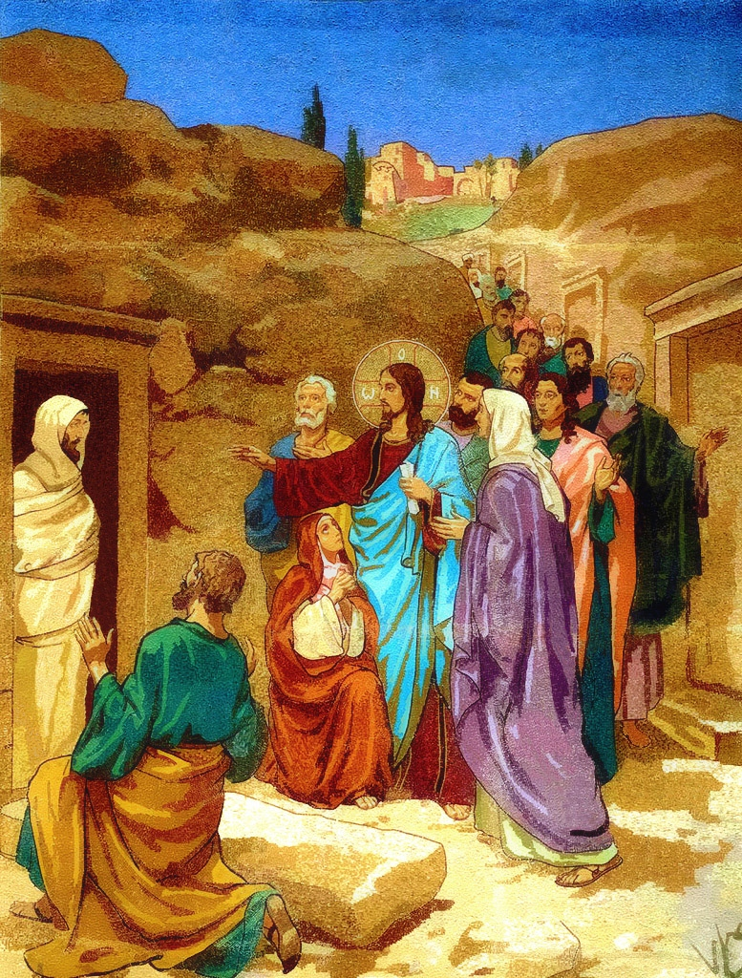

Slide 27
John 11:45 Then many of the Jews who had come to Mary, and had seen the things Jesus did, believed in Him. ⁴⁶ But some of them went away to the Pharisees and told them the things Jesus did.

Slide 28
John 11:47 Then the chief priests and the Pharisees gathered a council and said, "What shall we do? For this Man works many signs. ⁴⁸ "If we let Him alone like this, everyone will believe in Him, and the Romans will come and take away both our place and nation."

Slide 29
John 11:49 And one of them, Caiaphas, being high priest that year, said to them, "You know nothing at all, ⁵⁰ "nor do you consider that it is expedient for us that one man should die for the people, and not that the whole nation should perish." ⁵¹ Now this he did not say on his own authority; but being high priest that year he prophesied that Jesus would die for the nation, ⁵² and not for that nation only, but also that He would gather together in one the children of God who were scattered abroad.

Slide 30
John 11:53 Then, from that day on, they plotted to put Him to death. ⁵⁴ Therefore Jesus no longer walked openly among the Jews, but went from there into the country near the wilderness, to a city called Ephraim, and there remained with His disciples.

Slide 31
He started the last journey to Jerusalem, via Samaria and Galilee; healing ten lepers en route (Luke 17:11-37).
He gave two parables on prayers, those of the importunate (pleading) widow and the Pharisee and the publican (Luke 18:1-14).
He gave his teaching on divorce (Mark 10:1-12; Matthew 19:1-12).
He received little children (Mark 10:13-16, etc.).
He spoke with the rich young ruler and gave the parable of the laborers in the vineyard (Mark 10:17-31, and parallel accounts).

Slide 32
He gave the third prophecy of his death and resurrection and rebuked ambition of Zebedee's sons (Mark 10:32-45, etc.).
He healed Bartimaeus and a companion at Jericho (Mark 10:46-52, and parallel accounts).
He visited Zacchaeus, gave the parable of the pounds, and went on up to Jerusalem (Luke 19:142:8) (Coffman’s Commentary John 12)

Slide 33
John 11:55 And the Passover of the Jews was near, and many went from the country up to Jerusalem before the Passover, to purify themselves. ⁵⁶ Then they sought Jesus, and spoke among themselves as they stood in the temple, "What do you think -- that He will not come to the feast?" ⁵⁷ Now both the chief priests and the Pharisees had given a command, that if anyone knew where He was, he should report it, that they might seize Him.

